Slide 1
Rectangle intersection
Given a number of rectangles, determine which of them intersect.
Student: Dragos Geornoiu
Coordonator: Cristian Mihaescu

Slide 2
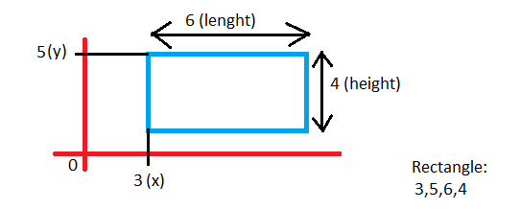
INPUT
An input file which defines on each line a rectangle
X - top left corner’s position on x axis
Y – top left corner’s position on y axis
Length
Height

Slide 3
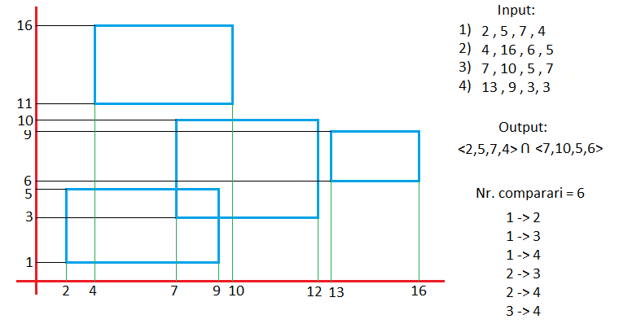
Brute Force

Slide 4
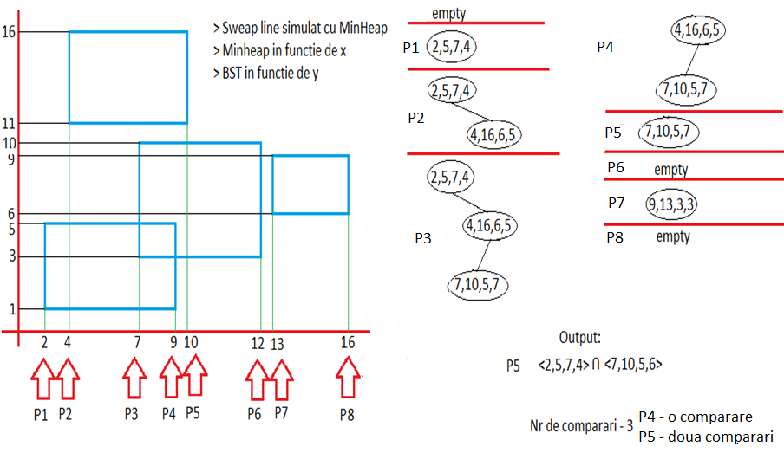
Sweep Line + BST

Slide 5
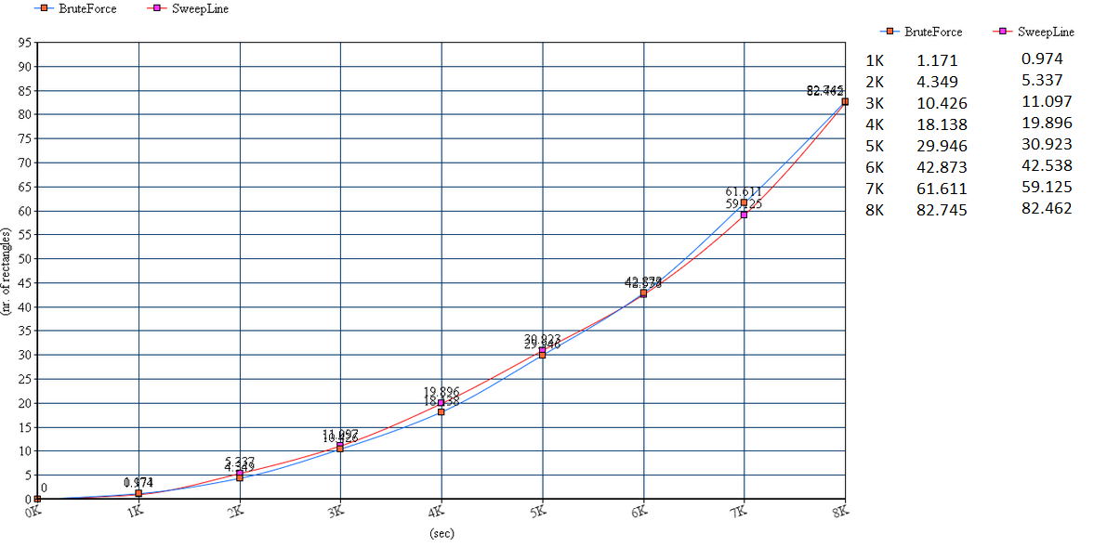
Standard Plot

Slide 6
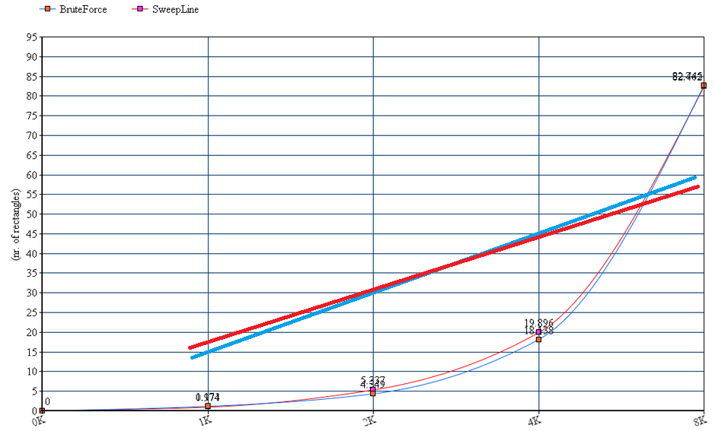
Log-Log Plot

Slide 7
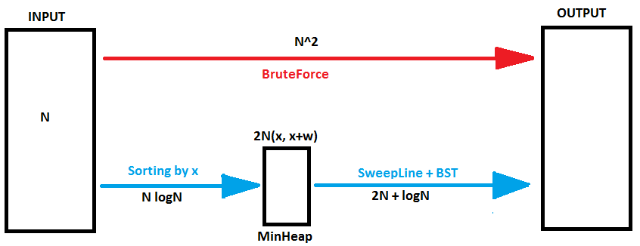

Slide 8
Order of growth | Algorithm Example | Input size solvable in minutes
2N+logN | Sweep Line + BST | Billions
N logN | Sorting | Hundreds of millions
N^2 | Brute Force (2 for loops) | Tens of thausands

Slide 9
Questions ?

